Slide 1


Getting
A Handle
On Risk
Risk Based
Testing Strategies
Clyneice Chaney
Software Test & Performance Corp
Project Performance Corporation
cchaney@ppc.com
All rights reserved
November 2006

Slide 2

Pressured Testers!!
When and why should
we stop testing?
How much testing
is enough?
When is the product
good enough for release?
How good is our
testing anyway?
Notes:
These are familiar questions. However answering theses questions calls for different answers than other times. A different perspective on testing is needed.

Slide 3
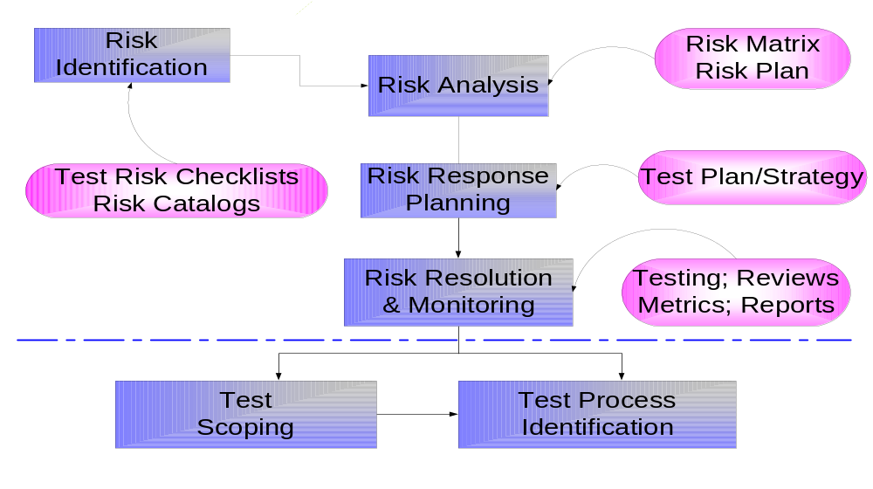
Risk Management & Testing
Notes:
Master test planning is our risk response planning activity
Test design implementation and execution are risk resolution activities
Tes execution management and monitoring are risk monitoring activities

Slide 4
Risk Based Testing
Risk Based Test
Management
Risk Based
Testing
Notes:
Risk based test management allocating resources to test activities according to particular product risks. Chief concern of risk based test management is which activities are most useful, how much of them should we do.
Risk based test design 0s process of designing tests that reveal information about particular product risks. The principal concern of risk based test design is whether the product will fail in a way that we fear it might. The outcome of risk based test design are tests designed to answer that fear.

Slide 5

Risk Based Test Process Answers:
When to Stop?
Typical
  All planned tests completed
  All incidents raised resolved
  All defects fixed and retested
  All regression test run w/o failure
Risk Based
  What are the risks of stopping NOW?
  What are the benefits of stopping NOW?
Have sufficient benefits been delivered?
Are there any critical problems?
Do we have the evidence to support a decision?

Slide 6
Risk Based Test Process
Risk Identification
Consult business and technical staff
Prepare a draft registrar of risks
Risk Analysis
Discuss risks
Assign probability & consequences
Calculate exposure
Formulate test objectives & test techniques
Document dependencies, requirements, times scales
Assign test effectiveness score
Nominate responsibilities
Risk Response
Test Scoping
Agree scope of risks to be addressed
Agree on responsibility and budget
Agree on quality criteria
Test Process
definition
Draft test process
Complete test stage definitions

Slide 7
Risk Identification
Risk Identification
Consult business and technical staff
    Prepare a draft list of risks

Slide 8
Identifying Software Risks
Project Risks
  Late tester involvement
  Mandated dates
Product Risks
  Platform
  Component
  Integration
  Infrastructure
  Usability
Process Risks
  Testing process
  Development process
  Project processes
Notes:
Risk workshops are an effective way to conduct risk identification and analysis. It should be done early in the master test planning meetings.
Common checklists on software risks abound. There are copies in your handout to use as a starting point.l

Slide 9

Risk Workshops
  Identify
  Consolidate
  Candidate
  risk lists
  Provide detail
Using
  Facilitated session
  Advance preparation
Notes:
This is a brainstorming session. Preparation

Slide 10
Using Checklists/ Catalogues
Project Based Checklists
Quality Centric Checklists
Product Based Checklists

Slide 11
Generic Risk Checklist
Potential risk (H, M, L, NA) | Module A | Module B | Module C | Module D
1. Heavily used module | High -5 | N/A -0 | Medium-3 | High- 5
2. Very complex module | High -5 | High -5 | Low -1
3. Modules “fixed” or updated often | Low -1 | Low -1 | Low -1 | Low -1
4. High availability functions | N/A -0 | N/A -0 | N/A -0 | N/A -0
5. Functions requiring consistent performance levels | Medium-3 | N/A -0 | Low -1 | Medium-3
6. Functions using new tools & languages | N/A -0 | N/A -0 | N/A -0 | N/A -0
7. Functions with many interfaces | N/A -0 | N/A -0 | Low -1 | Medium-3
Notes:
The risk assessment proposed is a simplified version of more formal risk assessment techniques that project managers often use. Fourteen of the most common risks identified by best practice literature are listed. The goal is to assess the risk for each high-level module/feature within a product. The tester reviews each listed risk and assesses the likelihood of that risk impacting the particular module/feature under consideration The table provides an example of a risk tool and completed assessment for four software modules (functions 1-4). The tool can be customized to include different risks for specific applications types such as e-commerce or object-oriented software projects.
A simple scale of low to high is used to rate the probability of that risk occurring for each feature. After each risk is rated, a risk score for each module or functionality is calculated.
1. Use the following scale when assessing risk for each module:
▪ N/A (0) - This risk doesn’t apply to this module or function
▪ Low (1) - This risk could occur, but it isn’t likely
▪ Medium Value (3) - This risk probably will affect this module or function
▪ High Value (5) - This risk definitely will impact this module or function
2. Rate each functional unit or module in the proposed system based on the likelihood of that risk occurring.
3. Calculate a risk score for each module.
4. Rank the modules, starting with the highest risk score.
The risk ranking is based upon a more qualitative approach (high, medium, low).

Slide 12
Quality Risks Checklist
Quality Expectations | Module A | Module B | Module C | Module D
Scale: Relative importance
1. Capability: Can it perform required features | High -5 | N/A -0 | Medium-3 | High- 5
2. Reliability: Will it work & resist failures in required situations | High -5 | High -5 | Low -1
3. Usability: How easy is it for real users? | Low -1 | Low -1 | Low -1 | Low -1
4. Performance: How speedy & responsive is it? | N/A -0 | N/A -0 | N/A -0 | N/A -0
5. Installability: How easily can it be installed? | Medium-3 | N/A -0 | Low -1 | Medium-3
6. Compatibility: How well does it work with external components? | N/A -0 | N/A -0 | N/A -0 | N/A -0
Notes:
Quality criteria: what would happen if requirements associated with any of the characteristics were not not? How much effort is justified in testing to assure that they are met to a “good enough”. Scales can be changed depending on style and preference. Some people use Normal, higher, lower. Everything is presumed to be a normal risk unless there is a reason to believe it is higher or lower risk. Use a scale that is meaningful to you.
High= very important
Medium= moderately/important
Low= not important
NA= not applicable at all to the function

Slide 13
Analyzing a Product
Identify the product
Identify the possible hazards
Rate risk
Determine risk acceptability
Determine risk mitigation
Reevaluate risk rating
Implement risk information in test strategy

Slide 14
Product Identification Approaches
Inside-out- study product and ask questions
    What could go wrong here?
    Vulnerabilities:What weakness or possible failures are there in this component?
    Threats: What inputs or situations could there be that might exploit a vulnerability and trigger a failure in this component?
    Victims: Who or what could be impacted by potential failures & how badly
Outside-in- begin with set of potential risks as in a checklist
    Quality criteria
    Generic risks
    Risk catalogs
Notes:
What k components have this kind of risks?
Begin with set of potential risks
Begin with risk checklists
Quality criteria
Generic risks
Risk catalogs
Easier than inside-out
What risks are associated with this thing?
Study the product and ask repeatedly:
What could go wrong here?
Vulnerabilities:What weakness or possible failures are there in this component?
Threats: What inputs or situations could there be that might exploit a vulnerability and trigger a failure in this component?
Victims: Who or what could be impacted by potential failures & how badly

Slide 15
Generic Product Risk Checklist
Potential risk (H, M, L, NA) | Module A | Module B | Module C | Module D
1. Heavily used module | High -5 | N/A -0 | Medium-3 | High- 5
2. Very complex module | High -5 | High -5 | Low -1
3. Modules “fixed” or updated often | Low -1 | Low -1 | Low -1 | Low -1
4. High availability functions | N/A -0 | N/A -0 | N/A -0 | N/A -0
5. Functions requiring consistent performance levels | Medium-3 | N/A -0 | Low -1 | Medium-3
6. Functions using new tools & languages | N/A -0 | N/A -0 | N/A -0 | N/A -0
7. Functions with many interfaces | N/A -0 | N/A -0 | Low -1 | Medium-3
Notes:
The risk assessment proposed is a simplified version of more formal risk assessment techniques that project managers often use. Fourteen of the most common risks identified by best practice literature are listed. The goal is to assess the risk for each high-level module/feature within a product. The tester reviews each listed risk and assesses the likelihood of that risk impacting the particular module/feature under consideration The table provides an example of a risk tool and completed assessment for four software modules (functions 1-4). The tool can be customized to include different risks for specific applications types such as e-commerce or object-oriented software projects.
A simple scale of low to high is used to rate the probability of that risk occurring for each feature. After each risk is rated, a risk score for each module or functionality is calculated.
1. Use the following scale when assessing risk for each module:
▪ N/A (0) - This risk doesn’t apply to this module or function
▪ Low (1) - This risk could occur, but it isn’t likely
▪ Medium Value (3) - This risk probably will affect this module or function
▪ High Value (5) - This risk definitely will impact this module or function
2. Rate each functional unit or module in the proposed system based on the likelihood of that risk occurring.
3. Calculate a risk score for each module.
4. Rank the modules, starting with the highest risk score.
The risk ranking is based upon a more qualitative approach (high, medium, low).

Slide 16
Documenting Risks
ID | Risk | Probability |  | Consequence | Exposure
Data Conversion
01 | Converting SS # to Non-privacy field may cause records to be lost
Integration
04 | Records created in scanning must be successfully accepted by workflow engine

Slide 17
Risk Analysis
Risk Analysis
Discuss risks
Assign probability & consequences
Calculate exposure
Notes:
We use risk analysis to direct attention to the most important concerns. Risks repent failure modes or high-level bug categories. So to direct testing we transform our risk concerns to an objective for testing. The test objective becomes the guidelines for the construction of detailed tests that shed light on the existence of ugs of a certain type.

Slide 18

Risk Analysis
Investigate the
risk further
Accept the
risk as valid
Delegate the risk
Determine it’s
testability
Group the lists
by similarity
Analysis
For each item
on the list:

Slide 19
Risk Response
Risk Response
Identify and document strategies for Process &
Project risks
Formulate test objectives & test techniques for
Product risks
Document dependencies, requirements,
times scales
Assign test effectiveness score
Identify role responsibility

Slide 20


Risk Response Planning
Preemptive Measures
(preventative)
Reactive
(risk reduction)
Notes:
Insufficient resources
Look at resource options
Scope/timeline change
Test Environment not available
Evaluate alternative options
Use alternative environment
Schedule environment in the evenings
Scope/timeline change
Hardware, Software people resource

Slide 21
Risk Response
Risk Response
Identify and document strategies for Process &
Project risks
Formulate test objectives & test techniques for
Product risks
Document dependencies, requirements,
times scales
Assign test effectiveness score
Identify role responsibility

Slide 22
Generic Test Objectives
ID | Test Objective | Typical Test Activity
01 | Demonstrate component meets requirements | Component Testing
02 | Demonstrate component ready for reuse in subsystem | Component Testing
03 | Demonstrate integrated components work together | Integration Testing
04 | Demonstrate system meets functional requirements | Functional testing
05 | Demonstrate meeting non-functional requirements | Nonfunctional testing
06 | Demonstrate meeting regulatory requirements | System /acceptance testing
07 | Demonstrate meeting contractual requirements | Contract acceptance
08 | Validate system meets business or user requirements | User acceptance testing
09 | Demonstrate system, processes, & people meet business requirements | User acceptance testing
Reprinted from Risk Based ebusiness Testing

Slide 23
Test Objectives & Activities
ID |  | Prob | Con |  | Ex |  | Objective |  | Test Activity | Role
 | Converting SS # to Non-privacy field may cause records to be lost | 4 | 4 |  | 16 |  | Verify tracability of SS # to all customer records |  | Integration | Test
Integration
 | Records created in scanning must be successfully accepted by workflow engine |  |  |  |  |  |  |  | Unit Test | Dev

Slide 24
Test Scoping
Test Scoping
Agree scope of risks to be addressed
Agree on responsibility and budget
Agree on quality criteria

Slide 25
Determining Scope
Evaluate the Risk and associated test objectives
Evaluate generic test objectives
Determine quality requirements for the project
With stakeholder and team determine testing scope

Slide 26
Plan to Test High Risk
Functions First
Core functions: critical and popular
Capabilities: which ones work
Common situations: popular data & paths
Common threats: stress & errors
User impact: failures with high impact
Most wanted: special interest by stakeholders
Modified slide Originally from James Bach, Rapid Software Testing.

Slide 27
Test Process
Test Process
definition
Draft test process
Complete test activities definitions

Slide 28
Test Process Determination
Evaluate Items from Test Process Worksheet
Define each test activity that is within scope
Defining the test activity
  Description
  Test objectives
  Entrance/exit criteria
  Environment
  Administrative: planning, executing, managing, signoff

Slide 29
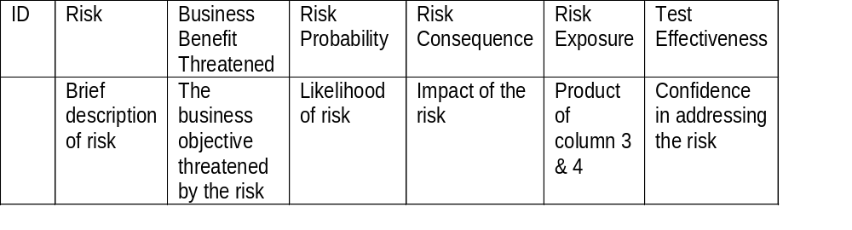
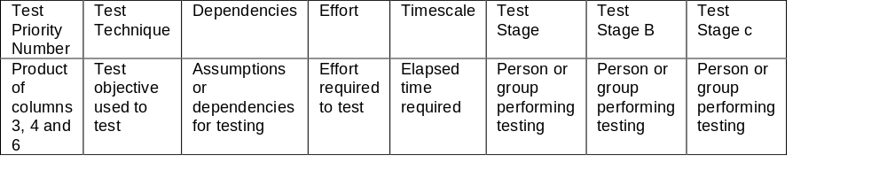
Documenting Strategy
Reprinted from Gerrard & Thompson
Risk Based eBusiness Test Strategy

Slide 30
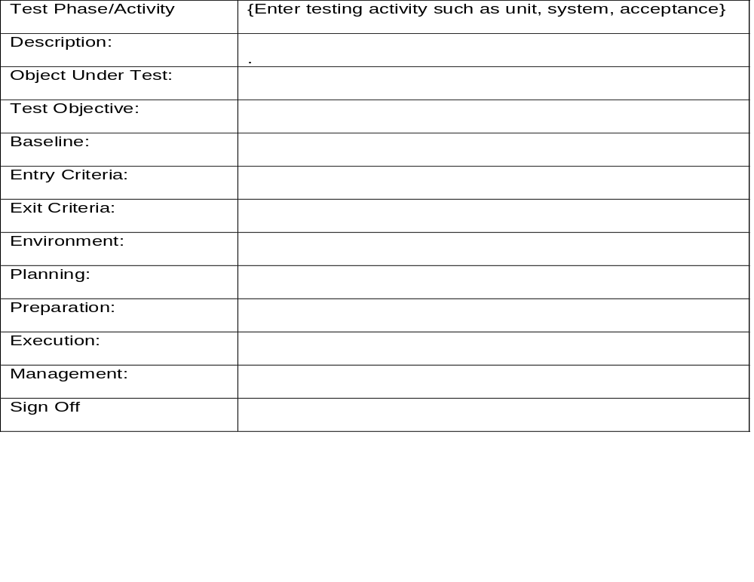
Test Activity Template
Reprinted from Gerrard & Thompson
Risk Based eBusiness Test Strategy

Slide 31
Managing Test Project Risks
Develop a workable schedule with frequent milestones to use in tracking the testing project
Aggressively fight slippage
Predict and track the likely causes of delay
Aggressively manage defect aging
Predict and track the likely causes of delay

Slide 32
Managing Test Project Risks
Have an early warning process to identify test bottlenecks and resolve them quickly.
Measure how time is being used
Be proactive, not passive
Don’t allow interpersonal conflict to get in the way
When Haste Can Make Waste

Slide 33
Reporting Risks
Impact
MEDIUM
HIGH
HIGH
High
Low Probability
High Probability
High Impact
High Impact
LOW
MEDIUM
HIGH
Medium
LOW
LOW
MEDIUM
Low
Low Probability
High Probability
Low Impact
Low Impact
Probability
Low
Medium
High
Notes:
Here is a simple example of a technique to get a basic risk assessment so you can use the resulting priorities to drive your test strategy and planning.
For the various risk factors for your project (at least some factors will be different for each project):
1. Determine if the probability is high medium or low. This is imprecise to some degree, but it gives us useful information.
2. Now get a determination (probably from someone on the user side) as to what the impact would be if the risk event actually occurs. Again, be satisfied with an answer of either high medium or small.
Plot your probability and impact evaluations for each risk on the above graph. Each will fall into one of the nine boxes on the graph. Now you can assign the exposure value high, medium, and low based on the position of the risk on the graph. For example in the graph shown here, the three boxes in the upper right hand corner are assigned a “high” exposure value; the diagonal boxes have been assigned “medium” exposure and the lower left hand corner boxes a “low” exposure value.
You can use this risk priority as a guide to the priorities for your testing efforts for this project.

Slide 34
Summary
Risk Based Test Strategy
Identify software product risks of concern
Design test activities that specifically address the risks
Create an optimal test process based on test activities
Plan & design tests to achieve objectives
Execute tests and report results

Slide 35
Risk Based Testing Manifesto
Assess software product risks
Estimate overall test effort
Gain consensus on amount of testing
Acquire budget to do enough testing
Plan, implement, and execute tests
Provide information for risk based release decision
Gerrard & Thompson

Slide 36
References
Risk Based e-Business Test Strategy. Paul Gerrad, Neil Thompson
Manage and Strengthen Testing: Speeding the Software Delivery Process, Part 1. Ross Collard
Conduct Early and Streamlined Testing: Speeding the Software Delivery Process, Part 2
Manage the Risks and the Process: Speeding the Software Delivery Process, Part 3
Troubleshooting Risk based testing. James Bach. 2003. Satisfice, Inc.

Slide 37

The End
clyneicechaney@ppc.com

